Slide 1
GRAFT
Lancaster CIC

Slide 2
THIS SESSION…
Think about the artist as a ‘problem-solver’
Think about the language/approach we take to ‘problems’ and ‘solutions’ in our careers/practices
Offer our observations with examples of different ways of thinking
Put this into practice with some group activities...

Slide 3
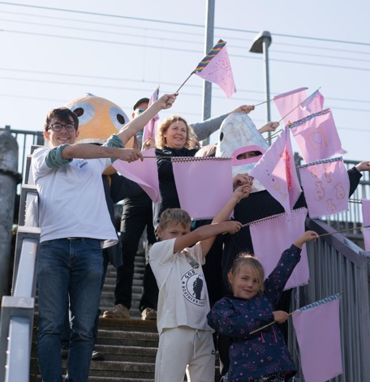
GRAFT…
Est. 2017
Lancaster based CIC
Support early-career artists
Creative opportunities for all

Slide 4
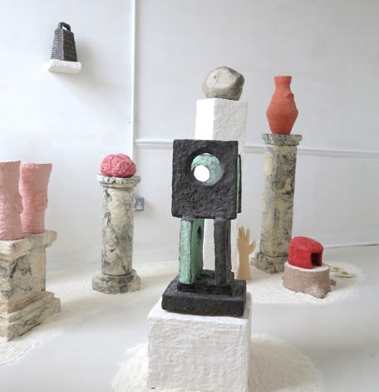
ELLIE…
PhD student at Lancaster
Exploring material meaning in practice and criticism
Looking at ways of democratising art making and writing

Slide 5
SITUATION #1:
TIME AND SPACE TO CREATE AND EXHIBIT NEW WORK IS OFTEN DIFFICULT TO ACCESS.

Slide 6
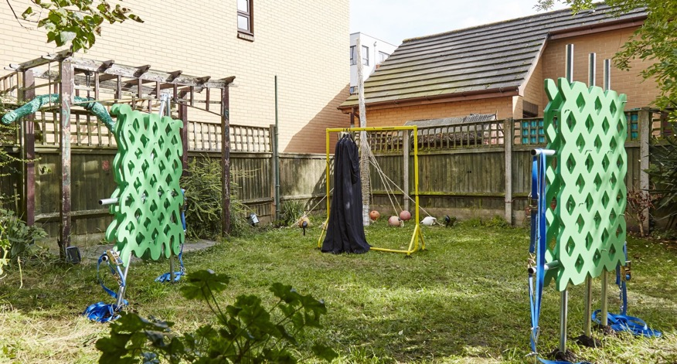
ALLEN ROAD SCULPTURE PARK WITH MICHAELA CULLEN, KARANJIT PANESAR, AND DOMINIQUE WHITE (2017)

Slide 7
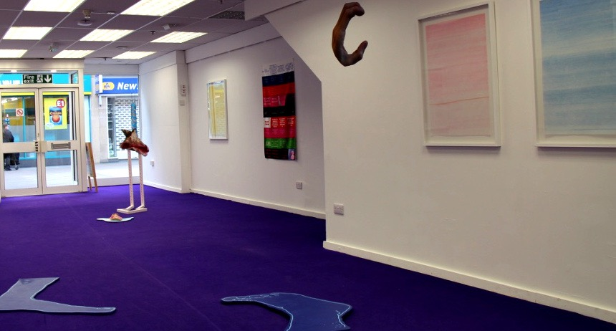
HARD GRAFT WITH JAWBONE JAWBONE, ROBYN NICHOL AND ANNE-MARIE WATSON IN ST. NIC’S ARCADE (2018)

Slide 8
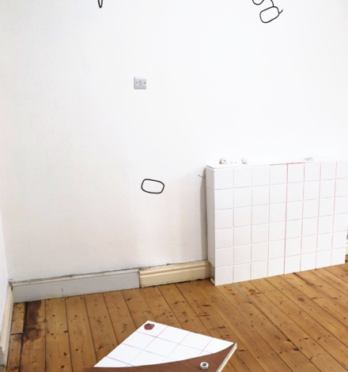
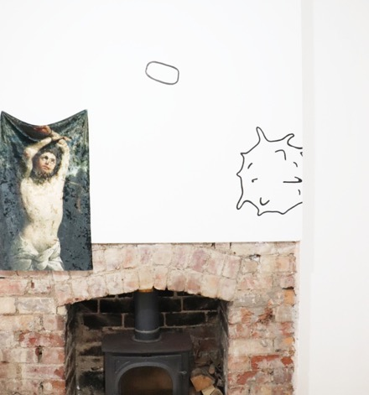
HOMEWORK BY JOE COTGRAVE FOR ARTLICKS WEEKEND (2018)

Slide 9
SITUATION #2:
IT CAN BE CHALLENGING TO GET HOLD OF THE MATERIALS AND EQUIPMENT YOU MIGHT NEED TO MAKE WORK.
Notes:
We’ve shaped this around 3 questions which we’d like you to help us answer at the end

Slide 10
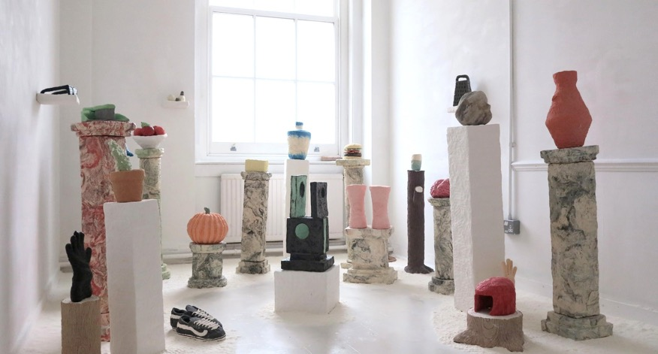
EXPLAIN THINGS TO ME AT SUBSIDIARY PROJECTS (2020)

Slide 11
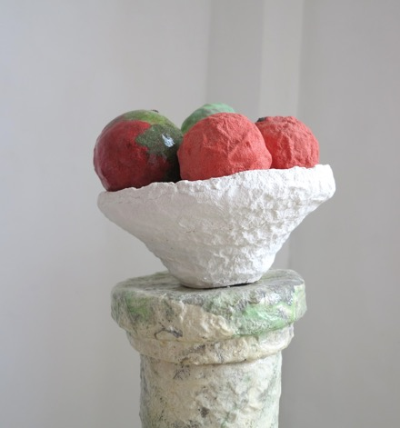
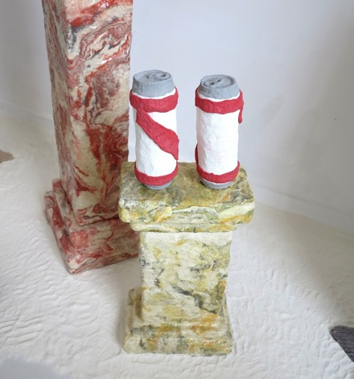
EXPLAIN THINGS TO ME AT SUBSIDIARY PROJECTS (2020)

Slide 12
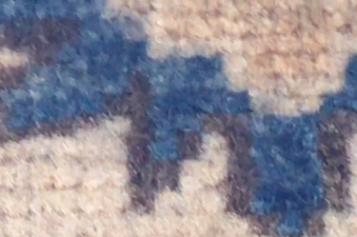
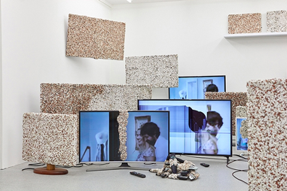
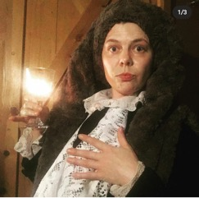
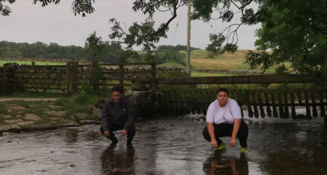
JAMIE JENKINSON
LAURA YUILE
SADE MICA
FAYE SPENCER

Slide 13
SITUATION #3:
IT IS DIFFICULT TO FIND OPPORTUNITIES FOR CAREER DEVELOPMENT, AND TO KNOW WHICH ONES ARE WORTH THE EFFORT!
Notes:
We’ve shaped this around 3 questions which we’d like you to help us answer at the end

Slide 14
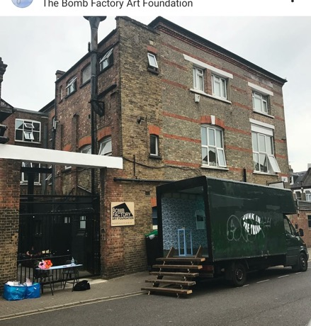
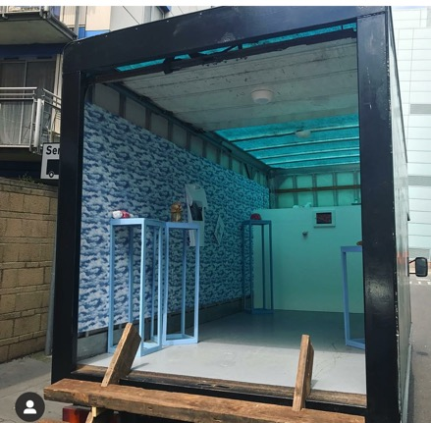
JUNK IN THE TRUNK BY YOUR BEAUTIFUL COLLECTIVE (2017)

Slide 15
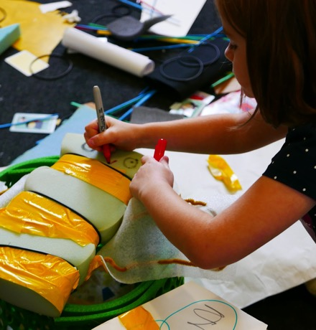
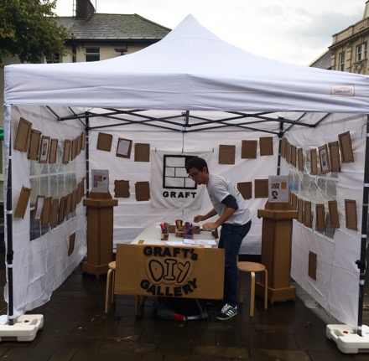
DIY AND FUN (2019)

Slide 16
Signal Film and Media (Barrow)
Prism (Blackburn)
Supercollider (Blackpool)
Abingdon Project Studios (Blackpool)
NEO Arts (Bolton)
Serf (Leeds)
Index (Leeds)
Double Negative (Liverpool/National)
Output (Liverpool)
Root-ed Zine (Liverpool)
PINK (Manchester)
Shy Bairns (Manchester)
The Exchange (Morecambe)
Newbridge Project (Newcastle)
Slugtown (Newcastle)
InSitu (Pendle)
The Birley (Preston)
Blaze Young Producers (Preston)
Artist Discussion (Wigan)
Cross Street Arts (Wigan)
The Fire Within (Wigan)
East Bristol Contemporary
Motion Sickness (Cambridge)
Turf (Croydon)
Stove (Dumfries)
12o Collective (London)
Bad Art (London)
Shelf (London/Wales/Margate)
Sluice (London)
Wells Projects (London)
Hot Desque (London)
Art Licks (London)
Ty Pawb (Wrexham)
BBZ BLK BK (National)
YAC (National)
Corridor 8 (National)

